Slide 1
360 Project:
Election Application
Brandi Durham, Austin Hollis, Justin Willis

Slide 2
Agenda:
Roles/Contributions
Vision
Background info
Requirements
Analysis
System Design
Objects
GRASP and GoF
Demo
Things we would do differently
Q&A

Slide 3
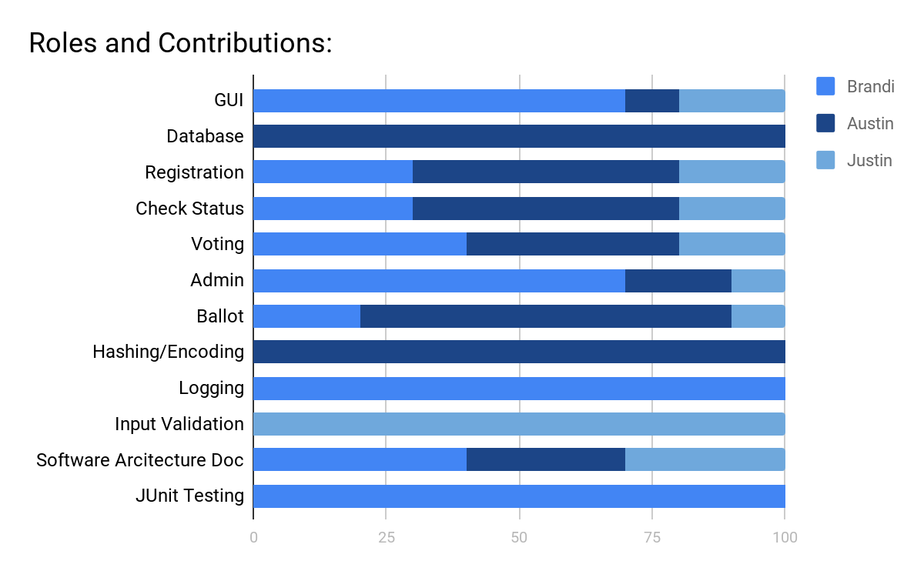
Roles and Contributions

Slide 4
Vision
To make a secure, easy to use e-election software application with the following features:
Easy to use and interact with
Keeps information and votes secure
Allows for immediate voting tally at any time
Unbiased candidate display
Easy to maintain
Quick and easy to understand instructions

Slide 5
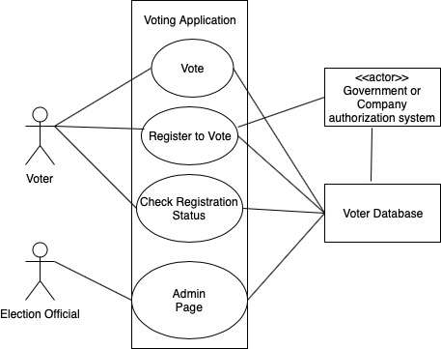
Background:
Our Use Cases:
User votes
User registers to vote
User checks registration status
Election official tallies votes

Slide 6
Requirements
Abide to legal aspects of voting system
Cast ballot (voter identifies themselves, selects, is notified about completeness
Check registration
Unofficial vote tally
Crosscheck double voting
Voter registration
Certify votes - recount, consistency
Database
Security - password handling
Security - sensitive private data securely store
Security - vote tampering
Performance
Usability

Slide 7
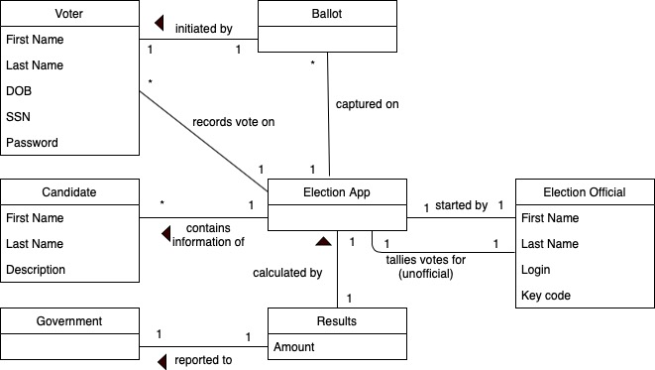
Analysis
Our Domain Model derived from our use cases.

Slide 8
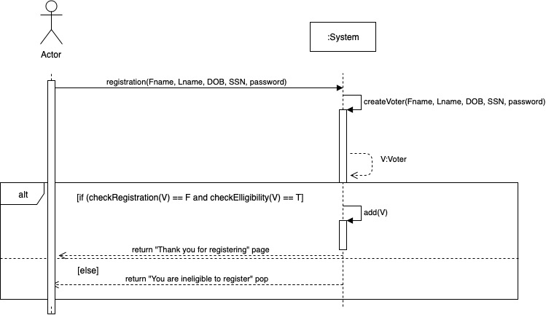
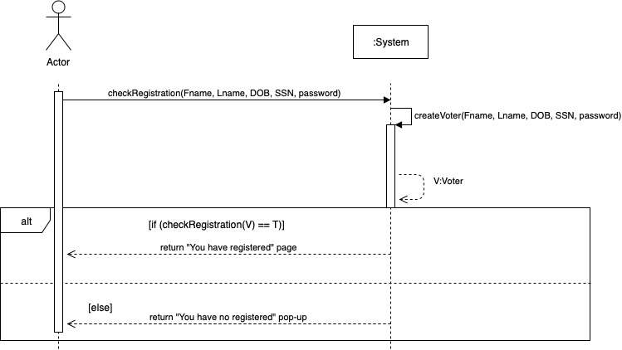
System Design
Voter Registration Page SSD Check Registration Status Page

Slide 9
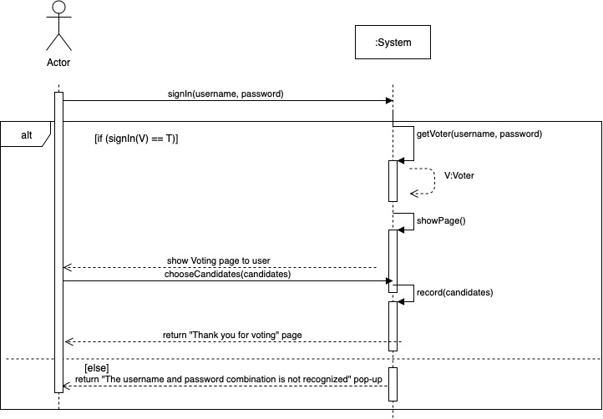
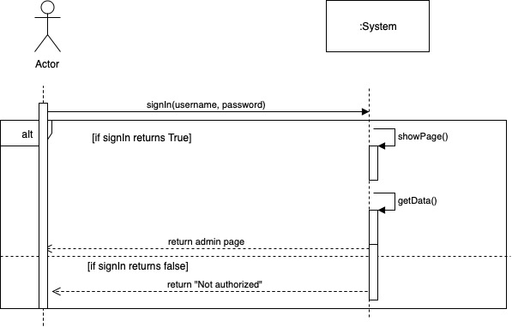
System Design
Voting Page SSD Election Official Page SSD

Slide 10
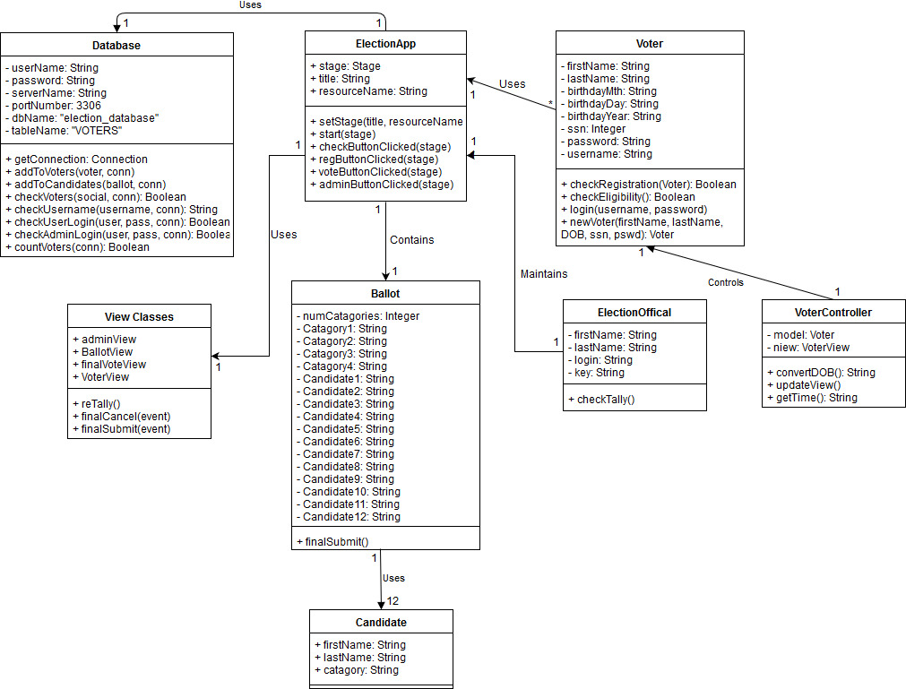

Slide 11
GRASP and GoF Patterns
SDs:
voterRegistrationPage
checkRegStatus
adminPage
votePage

Slide 12
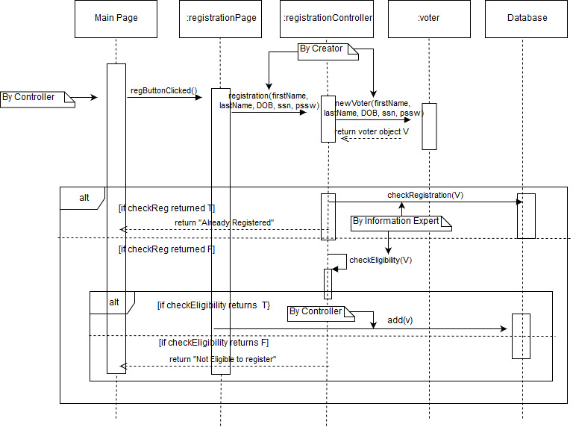

Slide 13
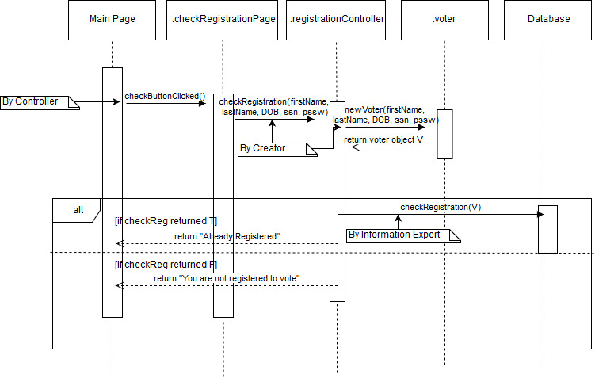

Slide 14
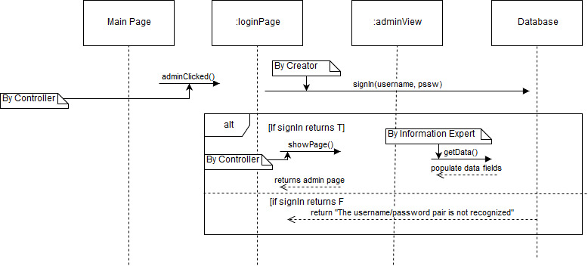

Slide 15
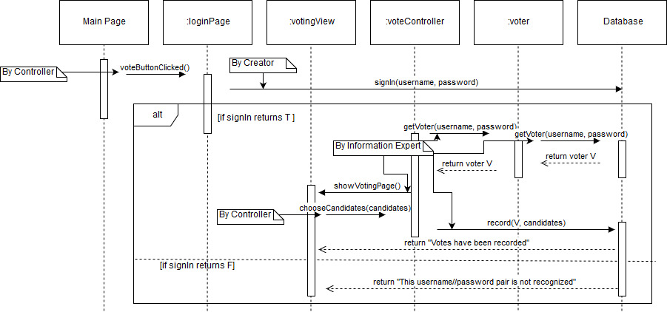

Slide 16
Demo

Slide 17
What we would do differently...
Use a boarder pane instead of a anchor pane so that the page is scalable.
Be able to use a cloud hosted database, like AWS

Slide 18
Q&A

